Slide 1

Term Project: The Effect of Turnovers on NBA Championship Team Scoring
Andrew Jordan
DSC 530-T301

Slide 2

The Question
Do turnovers significantly affect how many points an NBA championship team scores?

Slide 3

Five Variables
Field Goals (FG)
Field Goals Attempted (FGA)
Three Pointers (TP)
Three Pointers Attempted (TPA)
Turnovers (TOV)

Slide 4
Five Variables Described
Field Goals (FG): Total Baskets Made
Field Goals Attempted (FGA): Total Shots Taken
Three Pointers (TP): Three Point Baskets Made
Three Pointers Attempted (TPA): Three Point Shots Taken
Turnovers (TOV): Lose Possession Of The Ball To The Opposing Team Before A Shot Is Attempted

Slide 5
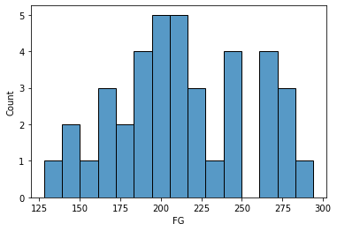
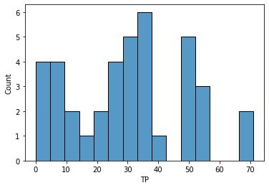
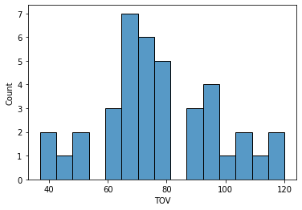
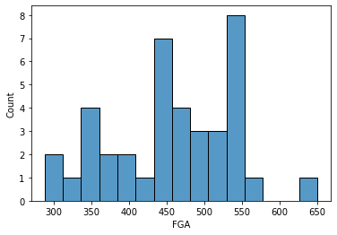
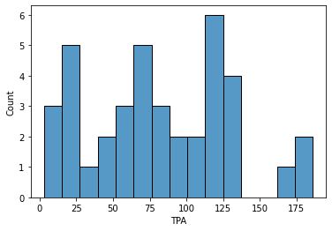
Five Variables Histograms

Slide 6
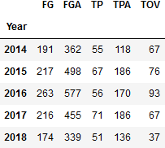
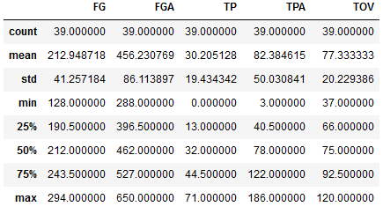
Mean, Mode, Spread, and Tails
Summary
Tails

Slide 7
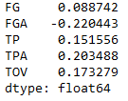
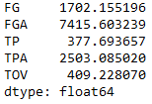
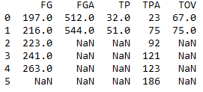
Mean, Mode, Spread, and Tails
Standard Deviation
Skew
Mode

Slide 8
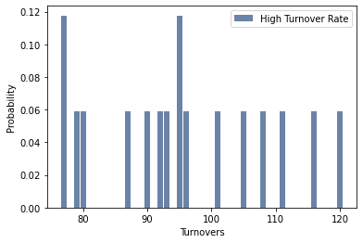
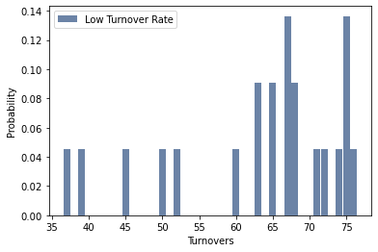
Probability Mass Function

Slide 9
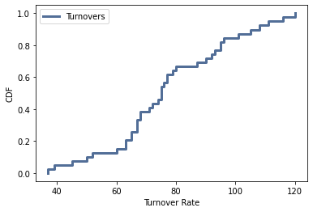
Cumulative Distributive Function

Slide 10
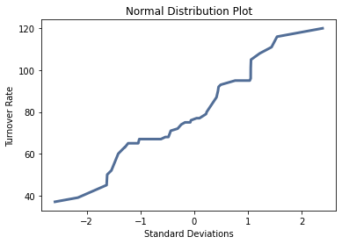
Analytical Distribution: Normal Distribution Plot

Slide 11
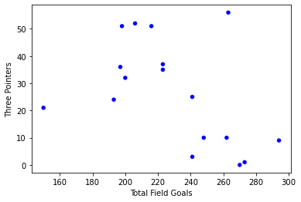
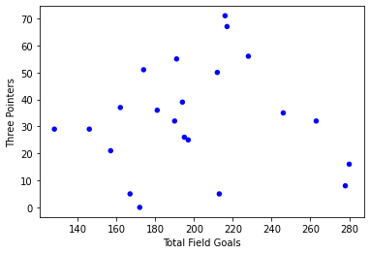
Scatter Plots
High Turnover Rate
Low Turnover Rate

Slide 12
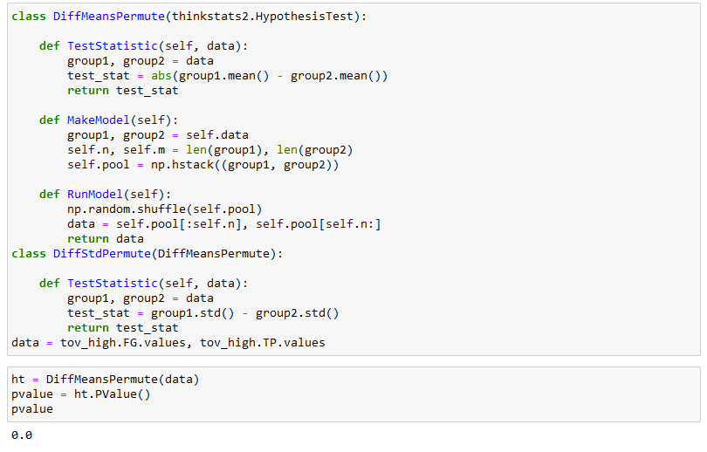
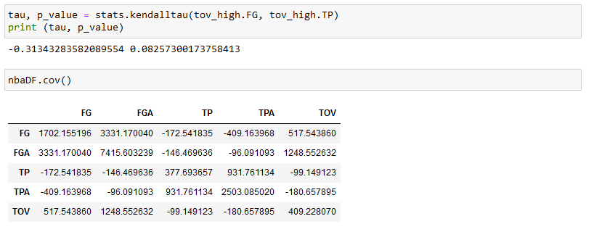
Testing Difference in Means by P-Value: Kendalls Tau + Permutation

Slide 13
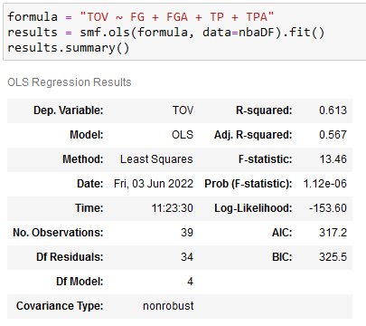
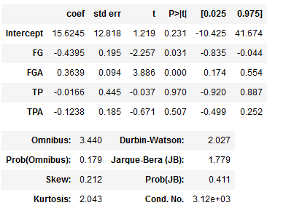
Regression Analysis

